Slide 1

CODE RED: A LARGE SCALE INFECTION
Jose Garcia
Deron Watson
Ronald Smith

Slide 2




Code Red Revisited
Computer Worm initiated on July 12, 2001 (Code Red I) and August 4, 2001 (Code Red II)
Spread worldwide
The infection of large number of computers
Spreading referred to as infectious epidemic as each infected computer passed on the virus

Slide 3
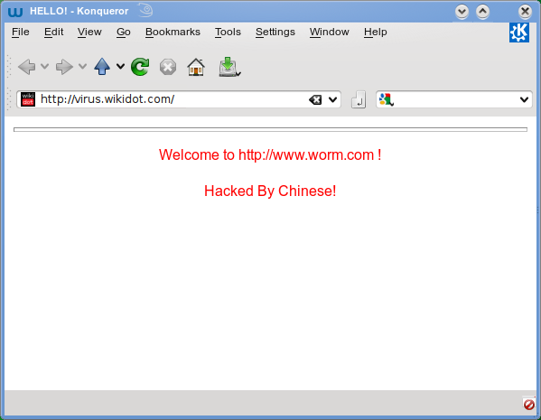
Exploit, Vulnerability and threat actor
CODE EXPLOITED COMPUTERS RUNNING THE MICROSOFT INTERNET INFORMATION SERVICES SERVER
THE VULNERABILITY WAS WITHIN MICROSOFT WINDOWS NT AND WINDOWS 2000
USED A KNOWN BUFFER OVERFLOW VULNERABILITY
UNKNOWN THREAT ACTOR BUT VIRUS CONTAINED TEXT LINE “HACKED BY CHINA”
ARTICLE IN THE JULY 30 2001 EDITION AUTHOR PONDERED IF THE VIRUS WAS THE BEGINNING OF THE APAOLYPSE

Slide 4
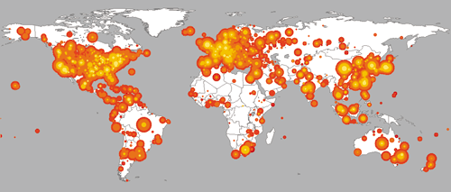
What's the damage?
Both Code Red I and Code Red II led to over 2 billion in damages
Cause the White House to change numerical IP web address due to the virus initiating a DDoS attack
Pentagon forced to take public sites off-line
July 19 saw 359,000 computers being infected on this day alone (Code Red Version II)
Infected 2000 new user per minutes with 43% of infected in the United States

Slide 5

Steps to Mitigate
Discovered by Marc Maiffret and Ryan Permeh
Called Code Red due to the discoverers drinking code red mountain dew when they found it
By August 10, 2001 Symantec created tool to perform vulnerability assessments and remove the virus from infected computers
IIS products were updated to eliminate the vulnerability the virus exploited

Slide 6
References
Delio, M. (2001, July 30). Code Red: Is This the Apocalypse? Retrieved from https://www.wired.com/2001/07/code-red-is-this-the-apocalypse/
Code red worm shows power of hackers. (2001, Aug 08). Sunday Business Post
Free vulnerability scan readies corporate infrastructures against 'code red' and 'code red II' worms. (2001, Aug 06). PR Newswire
Weaver, N. (2001, November). A Brief History of The Worm: Symantec Connect. Retrieved from https://www.symantec.com/connect/articles/brief-history-worm
Zhou, H., & Guo, W. (2017). A stochastic worm model. Telecommunication Systems, 64(1), 135-145

